Slide 1
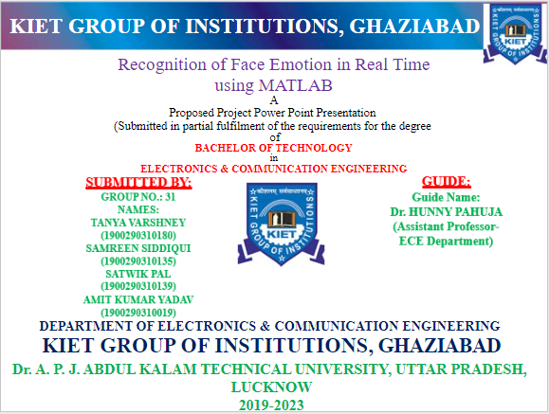

Slide 2
CONTENT
Introduction
Objective
Applications
Features for face recognition
Software and tools used
Steps for face emotion recognition using MATLAB software
Learning's till now
How to read an image in MATLAB
How to display it
How to convert image to gray image in MATLAB
Code for inserting web camera in MATLAB
Literature review
Way forward

Slide 3
INTRODUCTION
The term face emotion recognition refers to the method in which human beings’ emotions are recognized in the face. The most significant expression conveyed by the individuals is happiness. MATLAB is the best tool used for face emotion recognition.
Facial expression is an important indicator of a person’s emotion.​
Computers and other electronic devices in our daily lives will become more user-friendly if they can adequately interpret a person’s facial expressions, thereby improving human-machine interfaces.​
Facial expression recognition can be implemented in all computer interfaces, automated psychological research and treatment, robots or even polygraphs.

Slide 4
OBJECTIVE
The goal of this project is to predict, from the grayscale picture of a person’s face, which emotion the facial expression conveys.​
Our evaluation metric will be the accuracy for each emotion (fraction of correctly classified images), which highlights which emotions are better recognized than others.​

Slide 5
APPLICATIONS
Crime Identification
Spots out thieves
Detects politically aware arrogances
Detects driver’s low energy
Fraud prevention systems
Identifies & decreases forged insurance claims
Public Safety
Inspects crime scene footages for crime motives
Smart boundary controls & untruth detectors
Screening of public places to detect terrorism threats
Education
Identifies student’s engagement in virtual learning
Models emotional teaching system
Responses based learners learning track
Observes students’ responsiveness

Slide 6
continued...
Employment
Observes attention & mood swings of employees
Assists to decision making
Spots unresponsive applicants in interviews
Medicare
Prevents suicides
Patient condition monitoring
Aged people’s depression level identification
Mental disorders prediction & assistance
Identifies neurodegenerative & autism syndromes
Personalized Service Provision
Individual reaction prediction in movies, shops & ads
Facial expression tracking for marketing motives
Analyzing customers’ emotions in shopping
Personal recommendations in e-commerce
Analyzing the state of mind to display personalized messages

Slide 7
Features For Face Emotion Recognition
Expressions are identified by the features placed on the human faces.
As you know that, human faces are featured with some sensible features such as eyes, eyebrows, mouth, nose, and so on. These are the features that are helping the face emotion recognition system to exactly identify the emotion expressed by an individual.

Slide 8
Mouth
Humans habitually hide other emotions by their fake smiles. This can be identified by an eye’s micro-expression which always shows genuine feelings. They consider some of the positions of the feature to exactly identify the state of feeling as mentioned below,
Raised mouth’s single side – disgust or dislike
Downed mouth curves – depressed & unhappiness
Upturned mouth corners – happy
Dilated mouth – anxiety & fear
Plunged jawlines – surprise & wonder
Casing mouth – concealing feelings
Biting lips – nervousness
Tightened lips – dislike & distaste

Slide 9
Eyebrows
Eyebrows of the human can reveal the personal emotions of the intended person. In addition, they are very important for emotion recognition. The state of eyebrows positions can be considered as mentioned below,
Drained inner bends – sadness
Raised curves – wonder
Joined & dropped curves – panic, anger, trouble
Eyes
Eyes are the illustrating feature of human beings who can see the state of others’ feelings. Further, actions of the eyes can be well thought as,
Strong eyeing – thoughtfulness/hatred
Staring away – worry/diversion
Quick blinks – sorrow / distress
Short blinks – controlling eyes
Opened eyes – excitement / curiosity
The above listed are the major features that can convey the expressions of humans.

Slide 10
SOFTWARE & TOOLS USED
We are using MATLAB latest version i.e. Matlab_R2022b_win64 for this.
Toolboxes
‘Machine Learning ’ Toolbox
‘Image Processing’ Toolbox
‘Image Acquisition Toolbox
‘Deep Learning’ Toolbox
The listed above are the major toolboxes of Matlab used for recognizing the emotion expressed in human faces.

Slide 11
Steps For Face Emotion Recognition Using MATLAB Software
Step 1: Image selection
Reads the given image input
Step 2: Adding selected images into the database
Stores the selected images in the database & trains them
Step 3: Face express recognition
The selected image is processed to recognize the expression
Step 4: Database information
Illuminates the complete details of the database
Step 5: Removal of database
Terminates the prevailing database from the directory
Step 6: Program information
Showcases the information regarding software
Step 7: Source code of the process
Emphasizes the source code be used
Step 8: Exit
Exiting from program (quit)

Slide 12
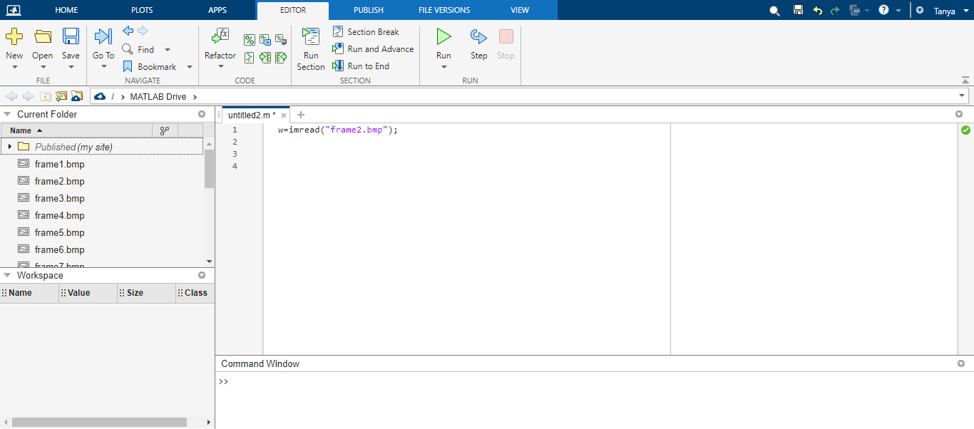
How to read an image
COMMAND : rgbImage = imread(“filename.fmt");

Slide 13
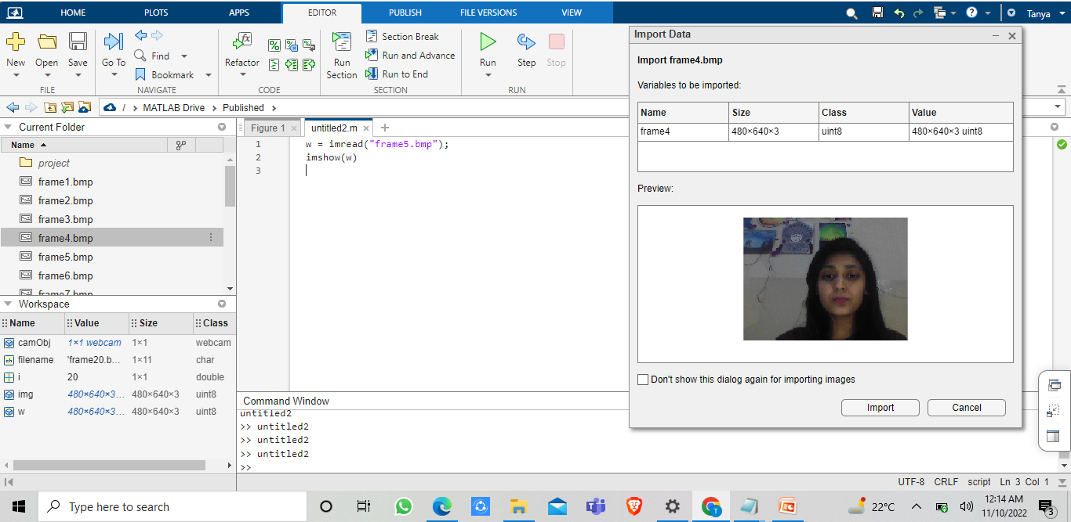
How to display an image
COMMAND: imshow(rgbimage);

Slide 14
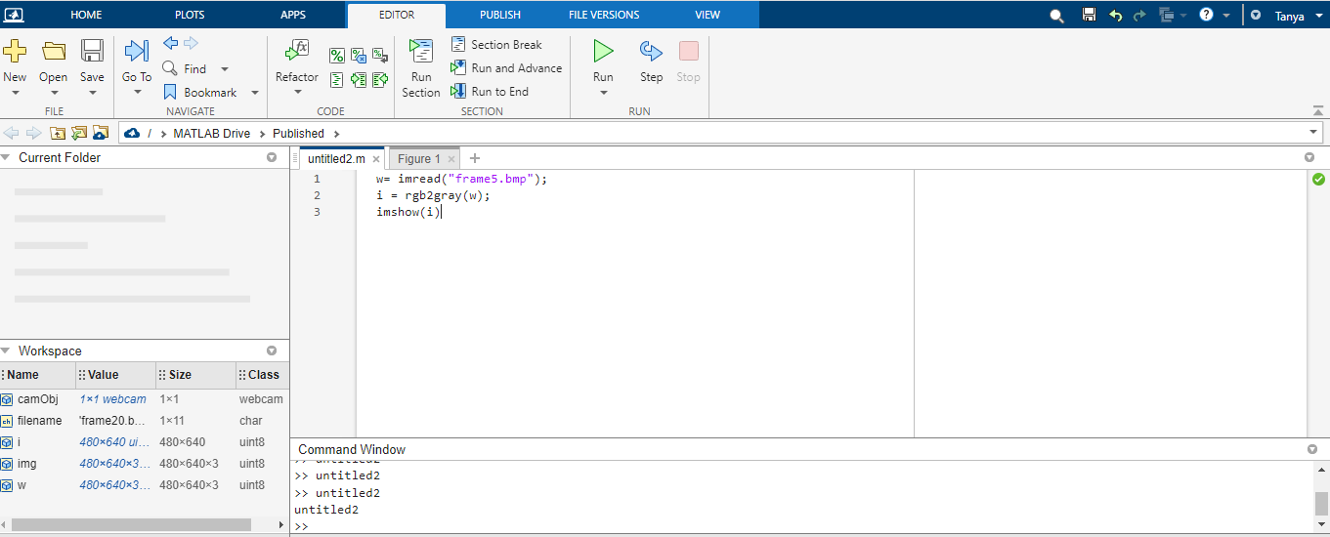
How to convert image to gray image
COMMAND: grayimage = rgb2gray(rgbimage);
imshow(grayimage)

Slide 15
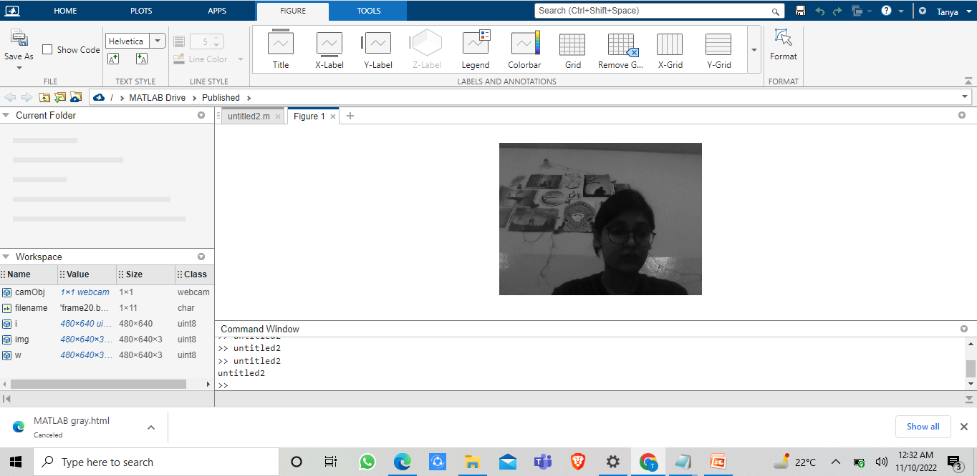
results....

Slide 16
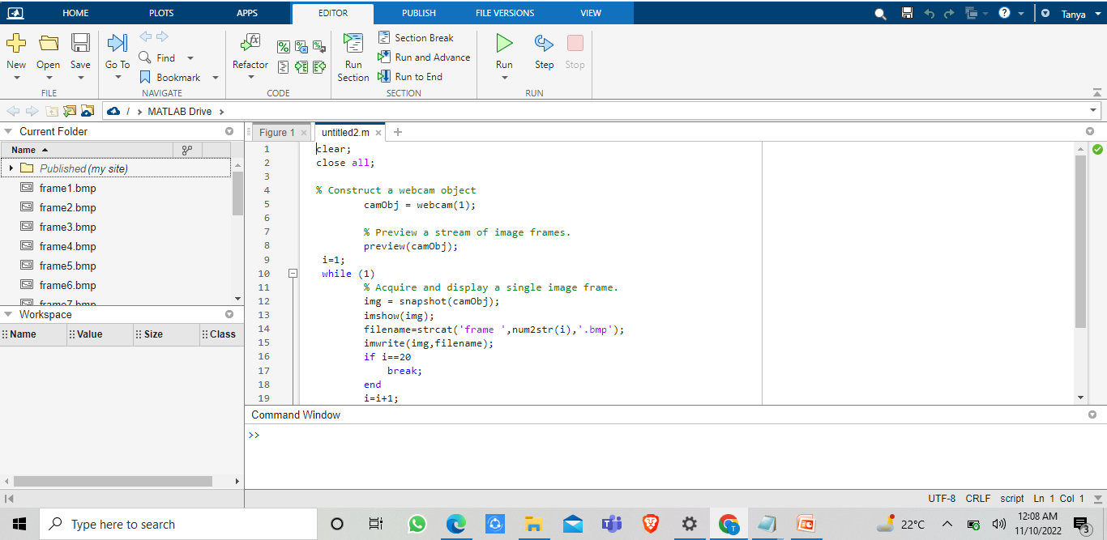
CODE FOR TAKING PICS FROM WEBCAM

Slide 17
LITERATURE REVIEW

Slide 18
A MATLAB based Face Recognition System using Image Processing and Neural Networks
This paper has presented a novel face recognition technique that uses features derived from DCT coefficients, along with a SOM-based classifier. The system was evaluated in MATLAB using an image database of 25 face images, containing five subjects and each subject having 5 images with different facial expressions. After training for approximately 850 epochs the system achieved a recognition rate of 81.36% for 10 consecutive trials. A reduced feature space, described for experiment 2 above, dramatically reduces the computational requirements of the method as compared with standard DCT feature extraction methods. This makes our system well suited for low-cost, real-time hardware implementation. Commercial implementations of this technique do not currently exist. However, it is conceivable that a practical SOM-based face recognition system may be possible in the future.
-Farrukh Nagi Universiti Tenaga Nasiona

Slide 19
Design and Implementation of Emotion Recognition System by Using MATLAB​
​
In this paper, we proposed an accurate and ​
high speed emotion detection system. The color and ​
feature-based detections were adopted to find skin
color fast and selected candidate blocks carefully.​
The major contribution of this paper is that the proposed ​
method can detect edges of the images and from that ​
edges distance between various features is calculated ​
by using Euclidean distance Formulae.​
​
-Neha Gupta and Prof. Navneet Kaur​

Slide 20
Identification and Recognition of Facial Expressions Using Image Processing Techniques​
​
The automatic facial expression recognition systems and ​various research challenges are overviewed. Various techniques can be used for better recognition rate. Techniques with higher recognition rate have greater performance. Emotion detection using facial expression is a universal issue and causes difficulties due to uncertain physical and psychological characteristics of emotions that are linked to the traits of each person individually.​
​
-J.D. Pujari, Dashrath. K. Bhadangkar, Rajesh. Yakkundimath​

Slide 21
Real Time Emotion Recognition through Facial Expressions for Desktop Devices​
In this paper we have proposed a system that automatically ​
detects human emotions on the basis of facial expressions. ​
This paper and the techniques followed are more suited as ​
this paper already uses the best of other approaches for face ​
recognition, thus limiting the latency in response. Moreover, ​
it further takes a step to improvise the emotion detection ​
technique using Cubic Bezier Curve Implementation which ​
is more adaptive and resurface as the ones with utmost ​
importance in various other fields like that of robotics, ​
computer graphics, automation and animation. The system ​
works well for faces with different shapes, complexions as ​
well as skin tones and senses basic six emotional ​
expressions.​
-P. M. Chavan, Manan C .Jadhav, Jinal B. Mashruwala, Aditi K. Nehete, Pooja A. Panjari​

Slide 22
A facial expression emotion recognition based human-robot interaction system​
​
A facial expression emotion recognition based human-robot interaction (FEER-HRI) system is proposed, for which a four-layer system framework is designed. The FEER-HRI system enables the robots not only to recognize human emotions, but also to generate facial expression for adapting to human emotions.​
​
-Zhentao Liu, Min Wu,
Weihua Cao, Luefeng Chen, Jianping Xu, Ri Zhang, Mengtian Zhou, Junwei Mao.​
​

Slide 23
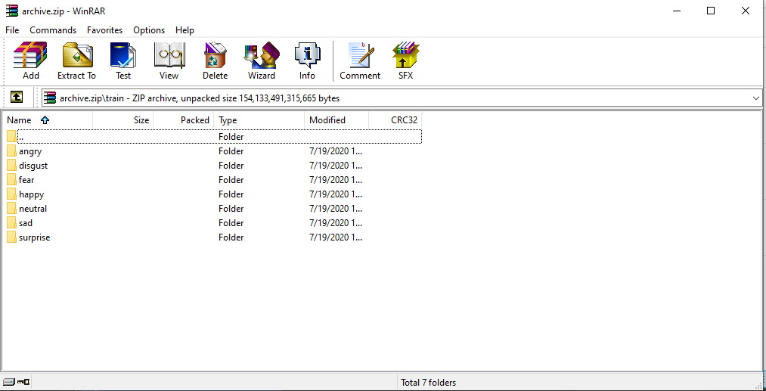
Way forward
For database, we have created our own database.
To read pixels i.e. we will make a code to detect a face .
Then our next step would be to train the model.
Then we are going to match our input images with the database directories..
FIG: database

Slide 24
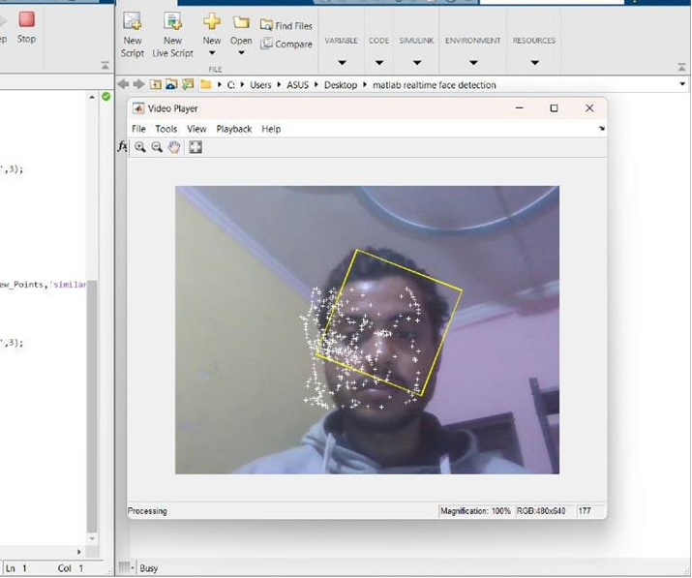
Track Face in Realtime
In this part we learn how to track a person face in realtime.

Slide 25
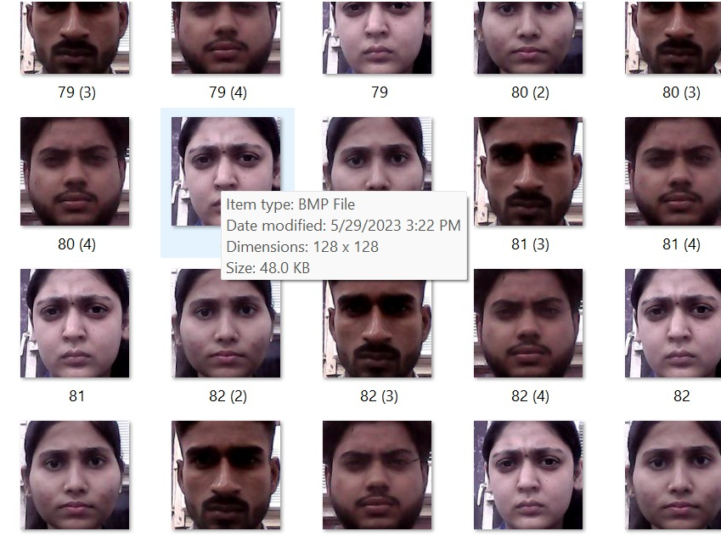
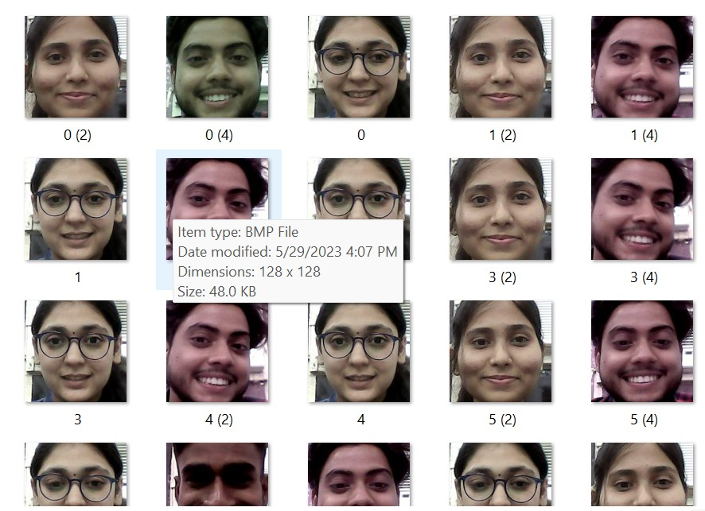
Some expression Images
We trained our model with these emotions.
Classifier.m file is created.
ANGRY
HAPPY

Slide 26
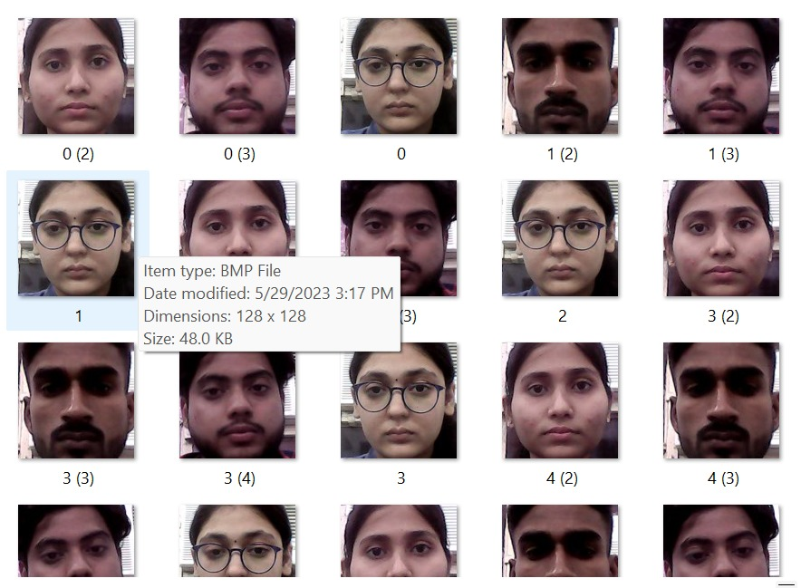
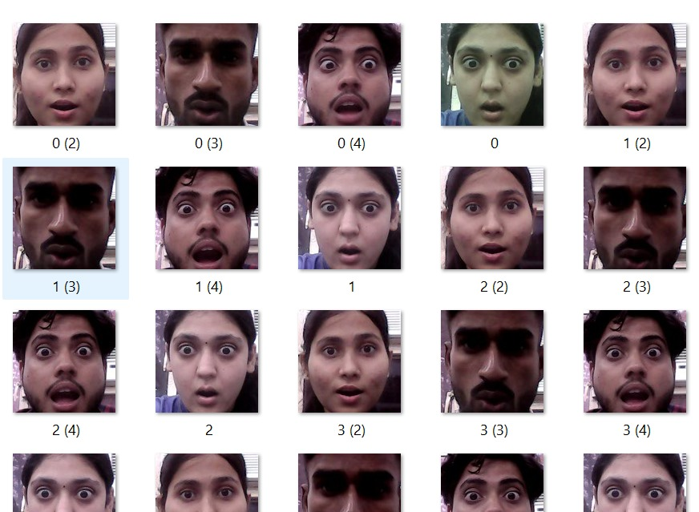
NEUTRAL
SURPRISED

Slide 27
Model Working
Model is already trained so it detect face in realtime.
Then it match the facial expression with emotions present in database.
Database is trained in Classifier.m file.
The final program fetch information from Classifier.m file
And finally show us the final result expression(in realtime)

Slide 28
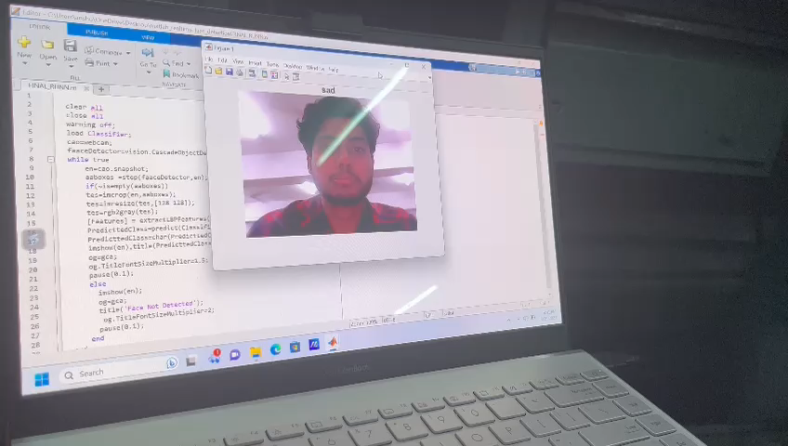
Model Working Video

Slide 29
THANK
YOU

